Slide 1
AFU_08504, BFU 08104, ACU_08103 INTERNATIONAL FINANCE
TOPIC 1:
INTRODUCTION TO INTERNATIONAL FINANCE AND
INTERNATIONAL MONETARY SYSTEM

Slide 2
1.1 INTERNATIONAL FINANCE

Slide 3
Coverage
International finance (IF) definition
Why study IF
Distinguishing IF and domestic finance
IF and the role of financial manager
Evolution of IF as an academic discipline and business activity
Recent trends in world economy
Indicators of internationalisation of finance
Forms of business firms engaged in international business
Operational environment of MC

Slide 4
International Finance: Definition
International finance is the study of the financial operations of corporate firms in an environment of open and integrated financial market.
That is, it is the study of financial interactions of corporations that transpire between two or more countries.
It is financial management for international corporate firm.

Slide 5
International Finance: Definition continued
International financial management covers many aspects of corporate finance such as:
Investment - an asset or item acquired with the goal of generating income or appreciation.
Financing - is the process of providing funds for business activities, making purchases, or investing.
Working Capital Management - Working capital represents the net current assets available for day-to-day operating activities.
Hedging - Attempts to reduce the amount of risk, or volatility, associated with price change.
Arbitrage - Arbitrage involves the simultaneous purchase and sale of a currency in different markets; the profit comes from the difference in the buying and selling prices.
Speculation - involves making a profit from difference in prices. Risk can be large for this

Slide 6
Why Study International Finance?
We are currently living in a world where all the three main economic functions namely consumption, production, and investment are highly internationalized.
Tanzanians, purchase TV sets and motor vehicles from Japan, garments from India and South East Asian countries, oil from Middle East countries and various types of machines from European countries.
Foreigners, purchase agricultural products, minerals and other mainly unprocessed products from Tanzania.
Production of goods and services has become highly globalized. Japanese cars, for instance, Toyota, sold in the world market might have been assembled in South Africa.
Multinational companies including financial markets are scattered all over the world which allows diversified portfolios internationally
Thus, fully understanding of the vital international dimensions of financial management has become indispensable to the financial manager.

Slide 7
International Finance and Domestic Finance difference
International finance differs from purely domestic finance in at least three dimensions.
Foreign Exchange and Political Risk - Companies in international business transactions are potentially exposed to foreign exchange risk.
Market Imperfections - Barriers that are detrimental to global business activities include legal restrictions, excessive transaction and transportation costs, and discriminatory taxation.
Expanded Opportunity Set - Firms can benefit from an expanded opportunity set through possibility of raising funds in capital markets across the globe, greater economies of scale due to deployment of firm’s assets on a global basis

Slide 8
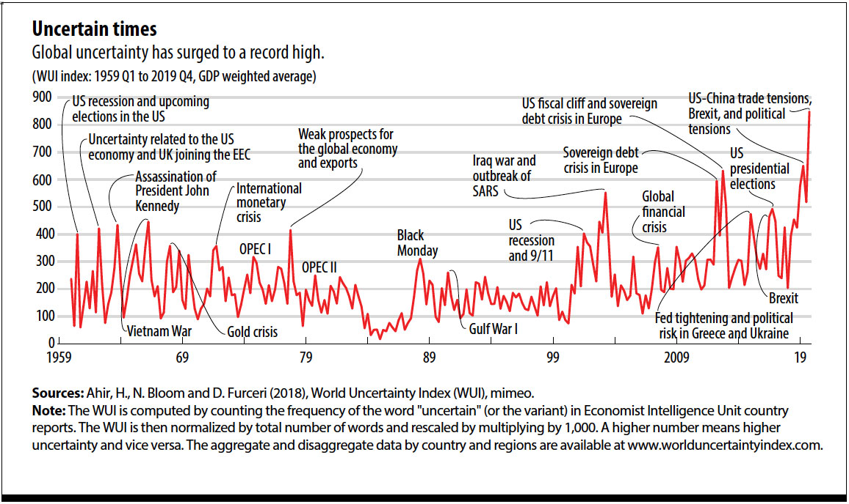

Slide 9
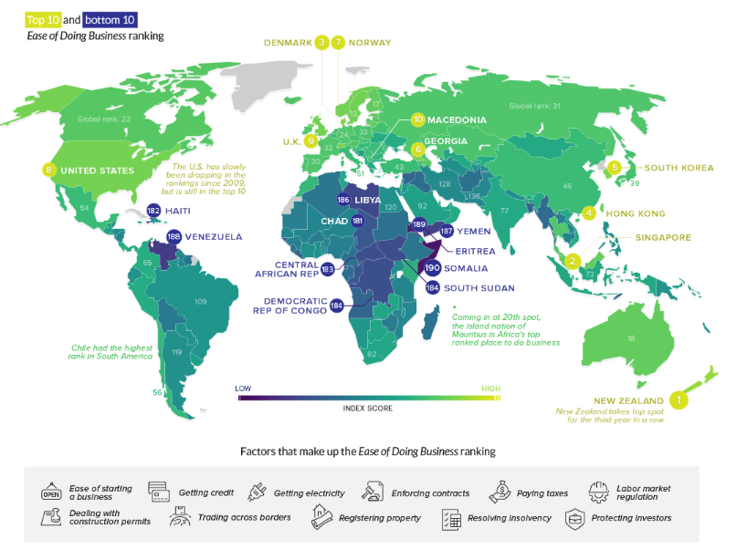

Slide 10
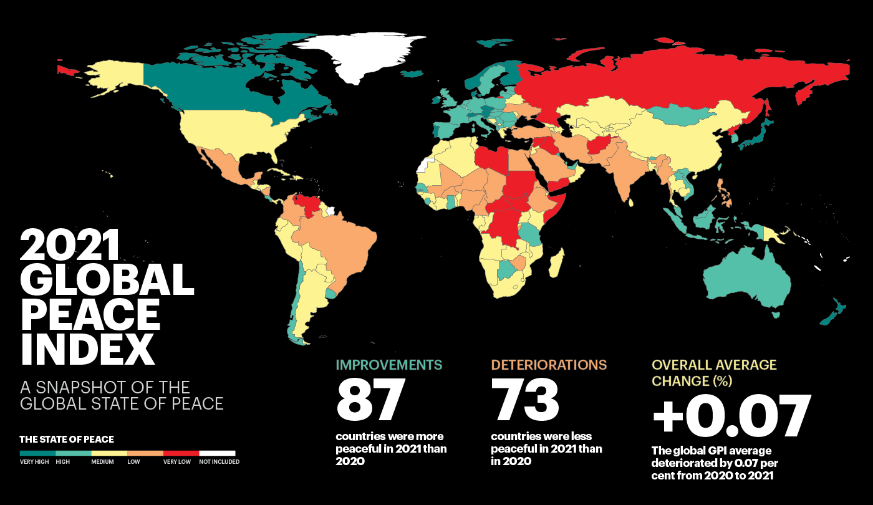

Slide 11
International Finance and the Role of the Financial Manager
A Financial Manager is a key decision-maker in an organization. They use data analysis and advise senior managers on profit-maximizing ideas.
Under IF they have to pay extra attention to the following as they have ramifications for the firm’s profitability and performance.
Fluctuations in exchange and interest rates - Determine firm’s cost of financing and return on investment. Volatility of exchange and interest rates implies volatility of profitability and raises the need for managing financial risks.
Balance of payments difficulties - The balance of payments difficulties affect interest and exchange rates and the economic performance of countries, since they are often viewed as a constraint on economic policy.
The international debt problem - Firms in general think seriously about country risk before taking any about doing business with a particular country.

Slide 12
All in all, the financial manager needs to be acquainted with the microeconomic environment in which the firm operates to execute the tasks effectively.
Precisely, financial manager need knowledge of:
Major economic indicators such as growth, inflation, unemployment and the balance of payments.
Government policies, including monetary, fiscal and structural policies.

Slide 13
Studying international finance is important for the financial manager for the following two principal reasons:
It helps the financial manager decide how international events will affect the firm, and which steps can be taken to take advantage of positive developments and protect the firm from harmful ones.
It helps the financial manager to anticipate events and to make profitable decisions before the events occur. Such events include for instance, changes in exchange rates; changes in interest rates; changes in national income; and changes in political environment.

Slide 14
Evolution of International Finance and Its Importance
International finance has assumed increasing importance at an accelerating rate, both as an academic discipline as an activity in which business firms get involved. The evolution of international finance in this context can be traced under two phases:
Phase I: World War II – Early 1970s
This period was characterized by the following:
A system of fixed exchange rates
The presence of stringent capital controls and
Segmentation of capital markets
International finance was not taught as a separate subject in higher learning institutions, rather as part of international economics, precisely as the financial counter part of international trade.
As for business firms, opportunities to engage in international or cross-country financing and investment were very virtually non-existence. International transactions were dominated by merely exports and imports. In addition, given a system of fixed exchange rates and the limited size of cross-country financial transactions, there was limited foreign exchange exposure. Consequently, hedging foreign exchange risk was not a major issue of concern.

Slide 15
Phase II: 1973 – To-date
With the collapse of the Bretton Woods system in 1971, major countries shifted to a system of flexible or floating exchange rates.
A decade later exchange rates were not only flexible but also very volatile.
Other important events characterizing this period include trends toward:
Flexible exchange rate system
Abolition of capital controls by many countries
Integration of Financial Markets
As an academic discipline, the field become concerned with important issues of exchange rate determination, and the sources and consequences of exchange rate volatility.
All the above also brought with it the need to hedge foreign exchange risk.
Volatility in exchange rate is relevant not only for firms with foreign operations but also those whose operations are purely domestic. An appreciation of the domestic currency will for instance, induce foreign competitors to enter the domestic market, and hence threatening the market share of purely domestic firms.

Slide 16
Recent Trends in World Economy
The economic and financial environment within which business firms operate at present is the result of a number of changes and developments in the world economy, all of which emerged after the World War II. Key trends of the world economy include the following:
International Financial Market Integration and Liberalization and Deregulation of Financial Markets
International Financial Market Integration
This is where boundaries between financial markets around the world have become rapidly blurred – it has resulted into a global unified financial market. Financial markets of a particular country are said to be integrated within the world’s financial markets if
There is free capital movement into and out of the country - domestic investors can buy foreign assets and foreign investors can buy domestic assets.
Substitution of domestic assets for foreign assets is possible.

Slide 17
Liberalization and Deregulation of Financial Markets
Liberalization and Deregulation in developed market involved action on two angles:
Eliminating the segmentation of the markets and introducing measures designed to foster greater competition.
Permitting foreign financial institutions to enter markets and compete on an equal footing with domestic financial institutions.
Banks have significantly increased their presence in each other’s countries.
Major national markets such as those of the United States, German, Japan are constantly being tapped by non-residents borrowers on an extensive scale.
Further, there has been a vivid trend towards functional unification. That is the traditional segmentation between commercial banking, investment banking, consumer finance, etc. is fast disappearing with the result that nowadays financial institutions are allowed to provide worldwide a wide range of financial services beyond what traditionally are supposed to carry out.

Slide 18
The fever of liberalization and deregulation has also swept the developing countries. Most developing countries began to liberalize their financial markets by allowing foreigners to directly invest in their financial markets. Tanzania embarked on the liberalization of her entire financial system from the early 1990s.

Slide 19
Indicators of Internationalization of Finance
There are several factors that indicate an ever-increasing internationalization of finance
Increase in international bank lending (including cross border lending and domestic lending denominated in foreign currency)
Banks’ cross-border claims stand at $37.7 trillion end of June 2023
Source: https://www.bis.org/statistics/rppb2310.htm
Increase in the value of securities transactions with foreigners, reflecting the belief in the benefits of international diversification despite the presence of foreign exchange risk.
Banks’ cross-border claims stand at $41.35 trillion end of 2021
Source: https://www.statista.com/statistics/242745/volume-of-global-equity-trading/
Increase in daily turnover (trading volume) in the global foreign exchange market.
Trading in OTC FX markets reached $7.5 trillion per day in April 2022, up 14% from $6.6 trillion three years earlier.
Source: https://www.bis.org/statistics/rpfx22_fx.htm#:~:text=Turnover%20in%20foreign%20exchange%20markets,panel%2C%20and%20Table%201).&text=The%2014%25%20growth%20since%20the,but%20two%20Surveys%20since%202004

Slide 20
THE MULTINATIONAL FIRM
Forms of Business Firms Engaged in International Business
The International Company - A firm engaged in the traditional international activity of business, namely importing and exporting. Basic international trade activity focus on the payment process between foreign buyer and domestic seller.
The Multinational Company (MC) - A company engaged in producing and selling goods or services in more than one country. It does business and has assets in two or more countries. Ordinarily consists of a parent company in the home country and foreign subsidiaries. Basic reasons for expansion into foreign markets include:
Competitive pressure in the domestic market;
The desire to produce more efficiently
The desire to lower operating costs.

Slide 21
Steps to becoming MC
Exporting - A Multinational produce domestically and export to one or more foreign markets.
Overseas Production - Exporting has the inability to realize the full sales potential of a product. Manufacturing abroad offers the multinational company several advantages:
Keep abreast of foreign market development, keep track of competition, adapt its products to changing local tastes and provide increased assurance of supply stability, can provide after-sales service.
Apart from overseas production we also have:
Licensing Agreement - An alternative to setting up production facilities abroad, MC may grant a license to an independent local producer to use the firm’s technology to manufacture the company's products in return for a license fee or a royalty. Among the principal advantages of licensing agreement include:
Minimal investment, faster market-entry and fewer financial and legal risks.
Joint Venture - MC may also establish a joint venture with a local foreign manufacturer. Joint venture with a local firm exposes the multinational firm to the least amount of political risk.

Slide 22
You may read
Johanson, J. and Vahlne, J.-E. (1977) ‘The Internationalization Process of the Firm—A Model of Knowledge Development and Increasing Foreign Market Commitments’, Journal of International Business Studies, 8 (1), pp. 23-32.
Johanson, J. and Vahlne, J.-E. (2009) ‘The Uppsala internationalization process model revisited: From liability of foreignness to liability of outsidership’, Journal of International Business Studies, 40 (9), pp. 1411-1431.

Slide 23
The Operational Environment of Multinational Companies
The Operational Environment of Multinational Companies
A multinational company faces a number risks that domestic firms do not. The basic types of risk faced by a multinational firm may be categorized in:
Political Risks
Exchange rate Risks
Political Risks
Ranges of political risks can be from mild interference to complete confiscation of all assets.
Political risk has a serious influence on the overall risk of an investment project and must be realistically assessed. Multinational companies have been using different methods for assessing political risks. Some hire consultants, others form their own advisory committees consisting of top-level managers from headquarters and foreign subsidiaries.

Slide 24
Exchange Rate Risks
This is the natural consequence of international operations in a world as relative currency values move up and down. There are three types of exchange rate risk exposures with which a multinational company is concerned:
Transaction Exposure - it is the risk that currency exchange rates will fluctuate after a firm has undertaken a financial obligation.
Translation Exposure - Translation of financial statements of a subsidiary company is usually done for consolidation purposes. Gain or loss may arise while translating the assets and liabilities of a foreign subsidiary into the parent company’s currency. This is called accounting or translation exposure.
Economic Exposure – Economic exposure, also sometimes called operating exposure, is a measure of the change in the future cash flows of a company as a result of unexpected changes in foreign exchange rates (FX). Economic exposure cannot be easily mitigated because it is caused by the unpredictable volatility of currency exchange rates.

Slide 25
The Transnational Company
As the multinational firm expands its branches, affiliates, subsidiaries, and network of suppliers, customers, distributors, marketers, and all others that fall the firm’s umbrella of activities, it is then described as a transnational firm.
Firms like Unilever, Philips, Ford, Sony etc. have intricate networks with home offices defined differently for products, processes, capitalization and even taxation.

Slide 26
1.2 THE INTERNATIONAL MONETARY SYSTEM

Slide 27
Coverage
International Monetary System (IMS): Definition
The history of IMS
Exchange rate regime classifications and the Euro
Attributes of the ideal currency
International financial institutions

Slide 28
International Monetary System: Definition
The international monetary system refers to the set of policies, institutions, practices, regulations, and mechanisms that determine the rate at which one currency is exchanged for another.
or
The international monetary system is a governing body that sets the rules and regulations by which different nations exchange currencies with each other.

Slide 29
The History of the International Monetary System
Bimetallism: Before 1975
The Classic Gold Standard: 1876 – 1913
Interwar Period: 1914 – 1944
Bretton Woods System: 1945 – 1972
The Floating/Flexible Exchange Rate Regime: 1973 – Present

Slide 30
Bimetallism: Before 1975
Both gold and silver were used as international means of payment.
This does not, however, imply that each individual country was on a bimetallic standard. For example, British = gold, France = gold and silver, Germany = silver
The collapse of bimetallism: The era experienced a phenomenon called Gresham’s Law – where countries did not trade on bimetallism anymore and adopting unilateralism.

Slide 31
The Classic Gold Standard: 1876 – 1913
Each country set the rate at which its currency unit (paper of coin) could be converted to a weight of gold.
For example, In United States $20.67 = 1 ounce of Gold. In Britain £4.2474 = 1 ounce of gold. The dollar/pound exchange rate was: $20.67/£4.2474 = $4.8665/£
Important Features - Exchange rates between currencies, was fixed, countries had to maintain adequate reserved of gold to back its currency’s value and it controlled inflation as growth in the amount of money was limited to the rate at which official authorities could acquire additional gold.
The collapse of gold standard: World War I interrupted trade flows and the free movement of gold. This event caused the main trading nations to suspend operation of the gold standard

Slide 32
Interwar Period: 1914 – 1944
The First World War had precipitated the collapse of the classical gold standard system and marked the end of a long era of fixed exchange rates.
During World War I and the early 1920s, currencies were allowed to fluctuate. Theoretically, supply and demand for a country’s exports and imports caused moderate changes in an exchange rate about a central equilibrium value. Unfortunately, such flexible exchange rates did not work in an equilibrating manner.
The United States adopted modified gold standards in 1934 when the U.S. dollar was devalued to $35 per ounce of gold from the $20.67 per ounce price in effect prior to World War I.
After the chaotic aftermath of the WWII, many of the main trading currencies lost their convertibility into other currencies. The dollar was the only major trading currency that continued to be convertible.

Slide 33
Bretton Woods System: 1945 – 1972
As World War II drew to a close in 1944, the Allied Powers met at Bretton Woods, New Hampshire, USA to create a new post-war international monetary system
The meeting (i.e., Bretton Woods Agreement )established an international monetary system based on convertibility of the various national currencies into a U.S. dollar that was in turn convertible into gold
Aim of these fixed exchange rates was to reduce the riskiness of international transactions helping to promote growth of world trade after WWII.
Two new institutions were also created - The International Monetary Fund (IMF) and the International Bank for Reconstruction and Development (The World Bank)
Bretton Woods system abandoned when the US unilaterally terminated convertibility of the dollar to gold in 1971 (effectively making it a fiat currency)

Slide 34
The Exchange Rate Regime: 1973 – Present
What is exchange rate regime?
It is the way a country manages its currency in respect to foreign currencies and the foreign exchange market.

Slide 35
FLOATING EXCHANGE RATE SYSTEM | Free float System | Exchange rate determined by market forces. Also known as independent or clean float
 | Managed Float System | Monetary authority intervenes directly or indirectly to stabilize the exchange rate and to keep it within desired limits. Also known as dirty float system
INTERMEDIATE EXCHANGE RATE SYSTEM | Band (target zone) | There is only a tiny variation around the fixed exchange rate against another currency, well within plus or minus 2%. For example, Denmark has fixed its exchange rate against the euro, keeping it very close to 7.44 krone = 1 euro (0.134 euro = 1 krone).
 | Crawling Peg | Hybrid of fixed and flexible exchange rate system where country established a par value of its currency in relation to another or a basket of currencies and then allows the par value to change gradually.
 | Crawling Band | The currency is adjusted periodically in small amounts at a fixed, preannounced rate or in response to changes in selective quantitative indicators .
 | Currency Basket Peg | A currency basket is a portfolio of selected currencies with different weightings. The currency basket peg is commonly used to minimize the risk of currency fluctuations. For example, Kuwait shifted the peg based on a currency basket consists of currencies of its major trade and financial partners.

Slide 36
FIXED EXCHANGE RATE SYSTEM | Currency Board | Pegs domestic currency to a foreign currency and allows the unlimited exchange of domestic currency for the foreign currency at the fixed exchange rate. Currency board is required to build reserves of foreign currency equivalent to the amount of domestic currency it had issued. For example, a developing country might set up a currency board and fix its exchange rate against the US dollar. For every bank note issued by the currency board, the board must have the equivalent value of financial assets in US dollars.
 | Dollarization | Several countries have suffered currency devaluation for many years, primarily as a result of inflation and have taken steps toward dollarization. Dollarization is the use of the U.S. dollar as the official currency of the country.
 | Currency Union/ Currency Bloc | Exist either as a formal arrangement or unofficially. Countries within the block try to fix their exchange rate against a major trading currency. For example, countries might belong to a US dollar currency bloc, and try to fix their exchange rate against the dollar.

Slide 37
THE BIRTH OF THE EUROPEAN CURRENCY: THE EURO
The euro (symbol: €; currency code: EUR) is the official currency of 20 of the 27 member states of the European Union.
The euro was established by the provisions in the 1992 Maastricht Treaty.
To participate, member states must meet strict criteria, such as a budget deficit of less than 3% of their GDP, a debt ratio of less than 60% of GDP, low inflation, and interest rates close to the EU average.
In the Maastricht Treaty, the United Kingdom and Denmark were granted exemptions per their request.

Slide 38
ATTRIBUTES OF THE IDEAL CURRENCY
If the ideal currency existed in today’s world, it would possess three attributes, often referred to as the “impossible trinity”
Exchange rate stability - Where traders and investors could be relatively certain of the foreign exchange value of each currency in the present and into the near future.
Full financial integration - Traders and investors could easily move funds, from one country and currency to another in response to perceived economic opportunities or risks.
Monetary independence - Domestic monetary and interest rate policies would be set by each individual country to pursue desired national economic policies, especially as they might relate to limiting inflation, combating recessions, and fostering prosperity and full employment.
The forces of economics do not allow the simultaneous achievement of all three. For example, a country with a pure float exchange rate regime can have monetary independence and a high degree of financial integration with the outside capital markets, but the result must be a loss of exchange rate stability (the case of the United States).

Slide 39
INTERNATIONAL FINANCIAL INSTITUTIONS
The international financial institutions that are central to the operation of international trade and finance were, created in the immediate post-war period. The most important of these are:
The International Monetary Fund (IMF)
The International Bank for Reconstruction and Development (IBRD) – more popularly known as the World Bank.
World Trade Organization (WTO)
The Bank for International Settlements (BIS)

Slide 40
THE INTERNATIONAL MONETARY FUND [IMF]
The IMF was founded in 1944 at an international conference at Bretton Woods in the USA but did not really begin to fully function until the 1950s. IMF is responsible for
Originally, IMF was responsible for
promoting international financial cooperation and establishing a system of stable exchange rates and freely convertible currencies,
providing a source of credit for members with balance of payments deficits while corrective policies were adopted and
Managing the growth of international liquidity partly by creating (1970) an international financial asset called Special Drawing Rights (SDR) - SDRs can supplement the official reserves of member countries.

Slide 41
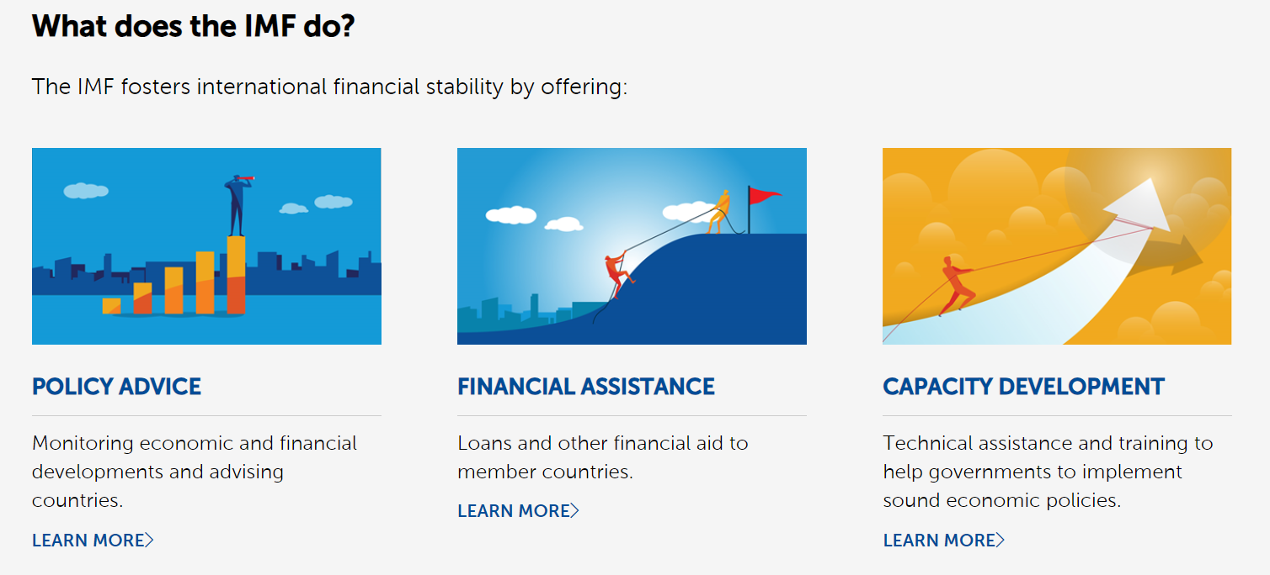
Refined functions of IMF
Read further at: https://www.imf.org/en/About/Factsheets/IMF-at-a-Glance#:~:text=The%20IMF%20has%20three%20critical,and%20with%20other%20international%20bodies.

Slide 42
Limitations/Hindrances of IMF
Originally, dollar centric system was the main limitation of IMF and world bank.
Now limitations include
Limited resources: The IMF has limited resources, which can limit the amount of assistance it can provide to countries in need.
Stigmatization: Bailout can stigmatize a country in the eyes of international investors, signaling that the country is unable to manage its own economy without outside assistance.
Harsh austerity measures: IMF programs often require countries to implement strict economic policies, which can be unpopular and difficult to implement.

Slide 43
THE WORLD BANK [IBRD]
The World Bank was the second institution created at the Bretton Woods meeting in 1944. Its membership and decision-making processes are similar to those of the IMF.
The original purpose of the IBRD was to help finance the reconstruction of economies damaged by the war. However, it soon shifted the focus of its lending to countries of the developing world. The bank now comprises four principal constituent elements:
IDA. The International Development Association.
IFC. The International Finance Corporation.
MIGA. The Multilateral Investment Guarantee Agency.
ICSID. The International Centre for Settlement of Investment Disputes.
More can be found at: https://www.worldbank.org/en/who-we-are

Slide 44
WORLD TRADE ORGANIZATION (WTO)
The World Trade Organization (WTO) is the only global international organization dealing with the rules of trade between nations.
The goal is to ensure that trade flows as smoothly, predictably and freely as possible.
It officially commenced operations on 1 January 1995, pursuant to the 1994 Marrakesh Agreement, thus replacing the General Agreement on Tariffs and Trade (GATT) that had been established in 1948.

Slide 45
THE BANK FOR INTERNATIONAL SETTLEMENT [BIS]
The Bank for International Settlement (BIS) was established at Basle in Switzerland in 1930.
Its initial task was organizing payment of German reparations dating the post- First World War settlement.
It now acts as a clearing house and banker for central banks. It receives deposits from central banks who are members of BIS. The principal functions of BIS are:
To encourage cooperation between central banks on matters associated with international payments.
To provide facilities for financial cooperation between central banks such as providing temporary credit for member banks

Slide 46
TASK
Explain the advantages and disadvantages of fixed and floating exchange rate system?
Explain the ways in which MNCs can lower political risks. To answer this, you may refer to articles, one for example - Giambona, E., Graham, J.R. & Harvey, C.R. The management of political risk. J Int Bus Stud 48, 523–533 (2017). https://doi.org/10.1057/s41267-016-0058-4

